Slide 1
Understanding Basic Characteristics of Data
Based in part on: Data Mining: Concepts and Techniques, Third Edition, by Han, Kamber, & Pei
Notes:
Before getting into deeper analysis involving predictive modeling or pattern discovery, it is important to understand the basic characteristics of the data set. This includes the types, statistics, and distributions associated with various features or attributes, as well as general patterns or relationships that can be observed among variables and data objects. Getting a feel for the data through descriptive statistics or visualization helps in formulating the appropriate hypotheses, target the right subsets of the data, and to identify the relevant data mining tasks to be performed in the KDD process.
Let’s first begin with some basic concepts and terminology related to data.

Slide 2
Attributes
Attribute (or dimensions, features, variables): a data field representing a characteristic or property of a data object
E.g., customer _ID, name, address, income, GPA, ….
Types:
Nominal (Categorical)
Ordinal
Numeric: quantitative
Interval-scaled
Ratio-scaled

Slide 3
Attribute Types
Nominal (Categorical): categories, states, or “names of things”
Hair_color = {auburn, black, blond, brown, grey, red, white}
marital status, occupation, ID numbers, zip codes
Often attributes with “yes” and “no” as values
Binary
Nominal attribute with only 2 states (0 and 1)
Ordinal
Values have a meaningful order (ranking) but magnitude between successive values is not known.
Size = {small, medium, large}, grades, army rankings
Month = {jan, feb, mar, … }
Numeric
Quantity (integer or real-valued)
Could also be intervals or ratios

Slide 4
Discrete vs. Continuous Attributes
Discrete Attribute
Has only a finite or countable set of values
E.g., zip codes, profession, or the set of words in a collection of documents
Sometimes, represented as integer variables
Note: Binary attributes are a special case of discrete attributes
Continuous Attribute
Has real numbers as attribute values
E.g., temperature, height, or weight
Practically, real values can only be measured and represented using a finite number of digits
Continuous attributes are typically represented as floating-point variables

Slide 5
Basic Statistical Descriptions of Data
Before deeper analysis, it’s important to explore the basic characteristics and relationships in the data set
Descriptive Statistics
To better understand the characteristics of attributes and fields: central tendency, variation, spread, etc.
To get a feel for general patterns or relationships among variables: e.g., correlation, covariance, etc.
Data Visualization
Visual examination of data distributions often help in uncovering important patterns and guide further investigation or decision making

Slide 6
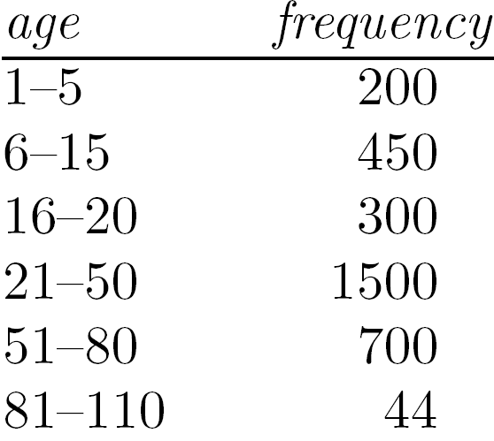
Measuring the Central Tendency
Mean (algebraic measure) (sample vs. population):
Note: n is sample size and N is population size.
Weighted arithmetic mean:
Trimmed mean: chopping extreme values
Median:
Middle value if odd number of values, or average of the middle two values otherwise
Estimated by interpolation (for grouped data):
Mode
Value that occurs most frequently in the data
Unimodal, bimodal, trimodal
Empirical formula:
Median interval

Slide 7
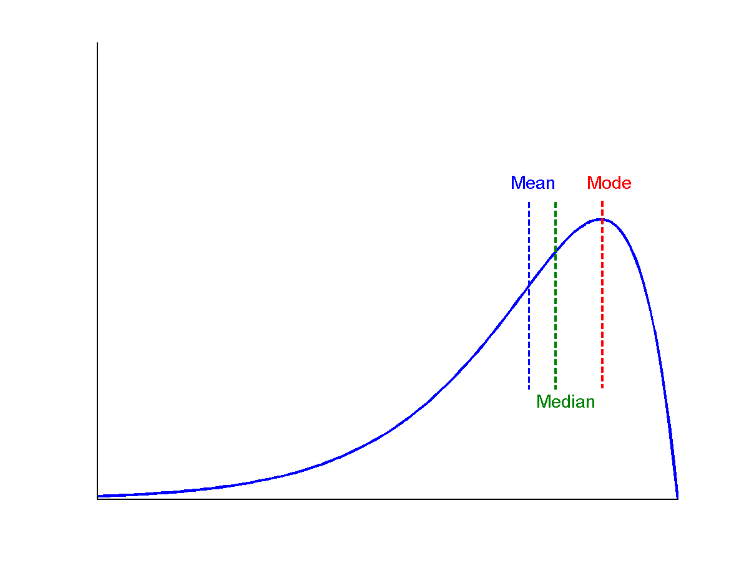
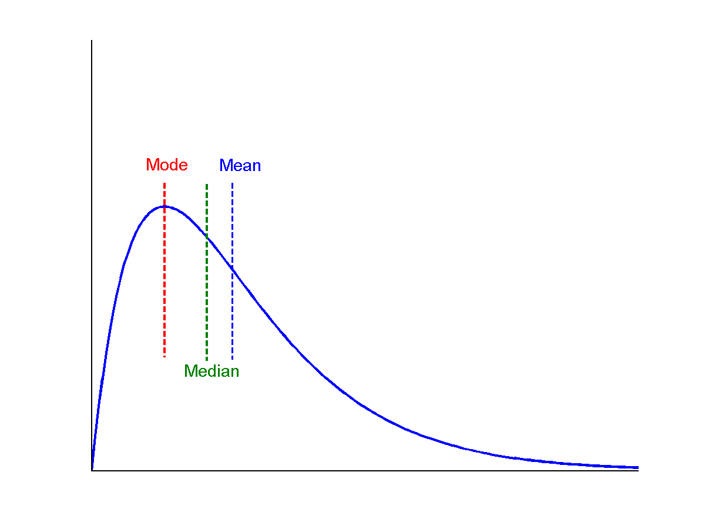
Symmetric vs. Skewed Data
Median, mean and mode of symmetric, positively and negatively skewed data
symmetric
positively skewed
negatively skewed

Slide 8
Measuring the Dispersion of Data
Quartiles, outliers and boxplots
Quartiles: Q₁ (25th percentile), Q₃ (75th percentile)
Inter-quartile range: IQR = Q₃ – Q₁
Five number summary: min, Q₁, median, Q₃, max
Boxplot: ends of the box are the quartiles; median is marked; add whiskers, and plot outliers individually
Outlier: usually, a value higher/lower than 1.5 x IQR
Variance and standard deviation (sample: s, population: σ)
Variance: (algebraic, scalable computation)
Standard deviation s (or σ) is the square root of variance s² ⁽or σ²⁾

Slide 9
Properties of Normal Distribution Curve
The normal (distribution) curve
From μ–σ to μ+σ: contains about 68% of the measurements (μ: mean, σ: standard deviation)
From μ–2σ to μ+2σ: contains about 95% of it
From μ–3σ to μ+3σ: contains about 99.7% of it

Slide 10
Graphic Displays of Basic Statistical Descriptions
Boxplot: graphic display of five-number summary
Histogram: x-axis are values, y-axis repres. frequencies
Quantile plot: each value x_{i} is paired with f_{i} indicating that approximately 100 f_{i} % of data are ≤ x_{i}
Quantile-quantile (q-q) plot: graphs the quantiles of one univariant distribution against the corresponding quantiles of another
Notes:
JH: Maybe we can remove Loess curve

Slide 11
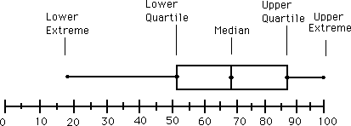
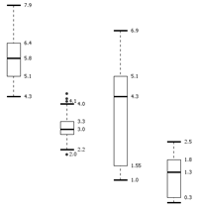
Boxplot Analysis
Five-number summary of a distribution
Minimum, Q1, Median, Q3, Maximum
Boxplot
Data is represented with a box
The ends of the box are at the first and third quartiles, i.e., the height of the box is IQR
The median is marked by a line within the box
Whiskers: two lines outside the box extended to Minimum and Maximum
Outliers: points beyond a specified outlier threshold, plotted individually

Slide 12
Histogram Analysis
Histogram: Graph display of tabulated frequencies, shown as bars
It shows what proportion of cases fall into each of several categories
Differs from a bar chart in that it is the area of the bar that denotes the value, not the height as in bar charts, a crucial distinction when the categories are not of uniform width
The categories are usually specified as non-overlapping intervals of some variable. The categories (bars) must be adjacent

Slide 13
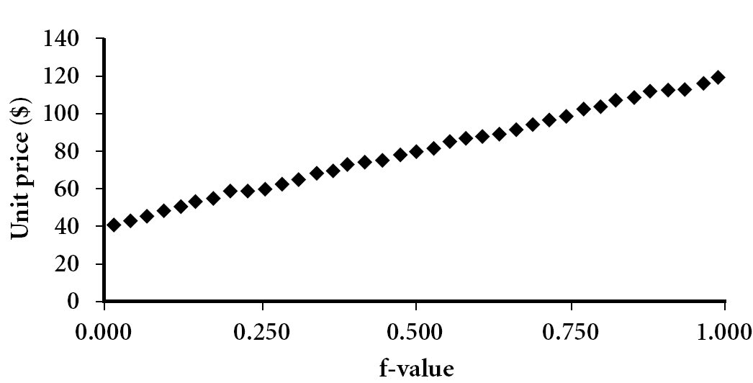
Quantile Plot
Displays all of the data (allowing the user to assess both the overall behavior and unusual occurrences)
Plots quantile information
For a data x_{i} data sorted in increasing order, f_{i} indicates that approximately 100 f_{i}% of the data are below or equal to the value x_{i}

Slide 14
Correlation Analysis (Nominal Data)
Example: Cross Tabulation
 | Windy | Not Windy
Outlook = sunny | 2 | 3
Outlook = rain | 2 | 3
Outlook = overcast | 2 | 2

Slide 15
Χ² (chi-square) test
The larger the Χ² value, the more likely the variables are related
The cells that contribute the most to the Χ² value are those whose actual count is very different from the expected count
Correlation does not imply causality
# of hospitals and # of car-theft in a city are correlated
Both are causally linked to the third variable: population

Slide 16
Chi-Square Calculation: An Example
Χ² (chi-square) calculation (numbers in parenthesis are expected counts calculated based on the data distribution in the two categories)
It shows that like_science_fiction and play_chess are correlated in the group
 | Play chess | Not play chess | Sum (row)
Like science fiction | 250(90) | 200(360) | 450
Not like science fiction | 50(210) | 1000(840) | 1050
Sum(col.) | 300 | 1200 | 1500

Slide 17
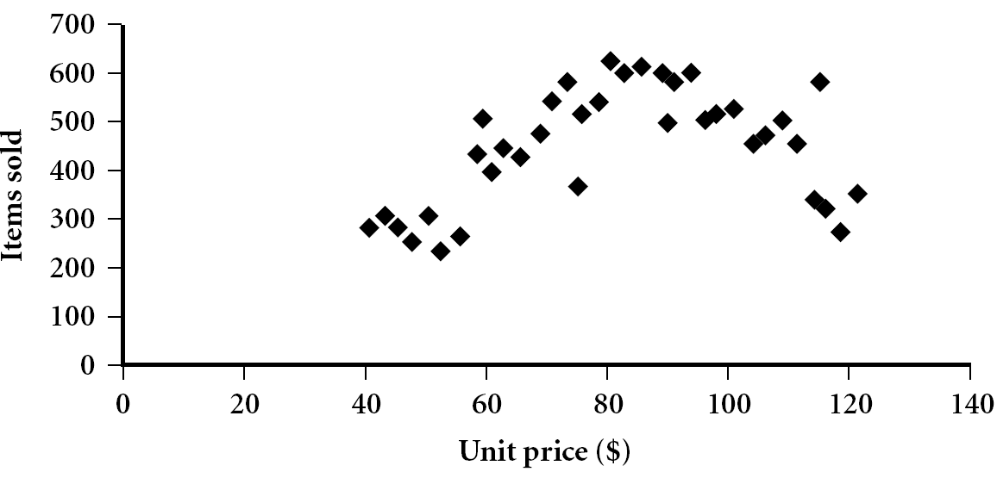
Correlation Analysis (Numeric Data)
Scatter plot
Provides a first look at bivariate data to see clusters of points, outliers, etc
Each pair of values is treated as a pair of coordinates and plotted as points in the plane

Slide 18
Positively and Negatively Correlated Data
Above-left: positively correlated
Above-right: negative correlated

Slide 19
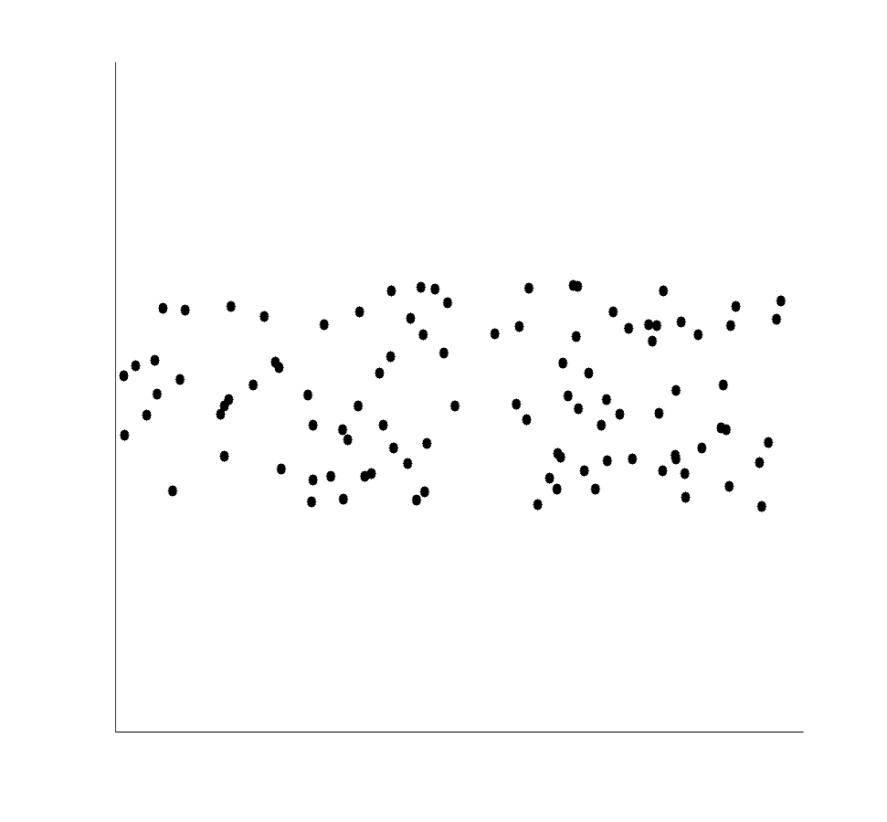
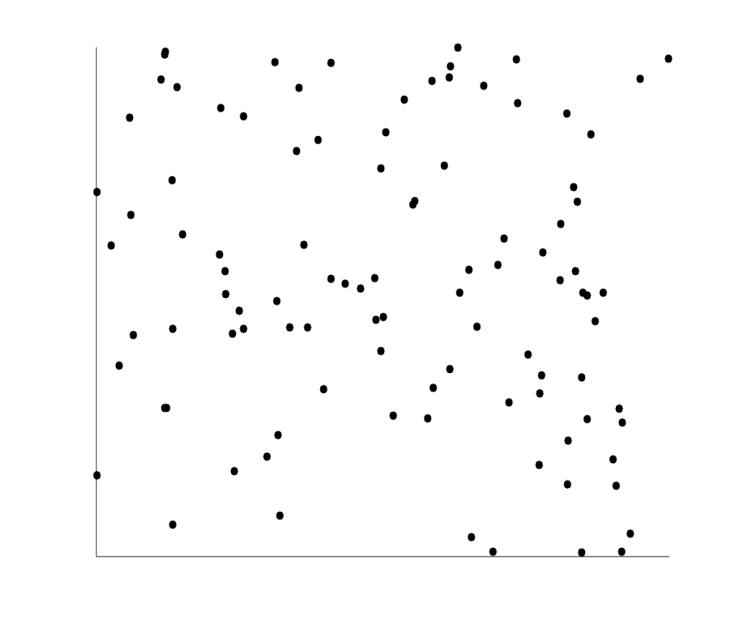
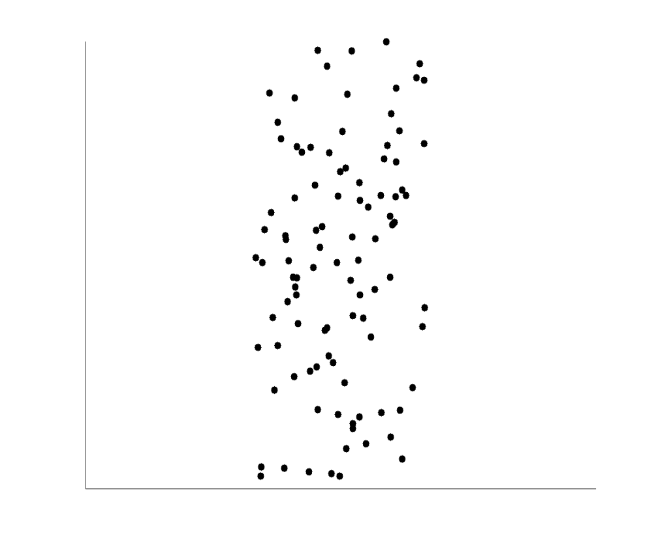
Uncorrelated Data

Slide 20
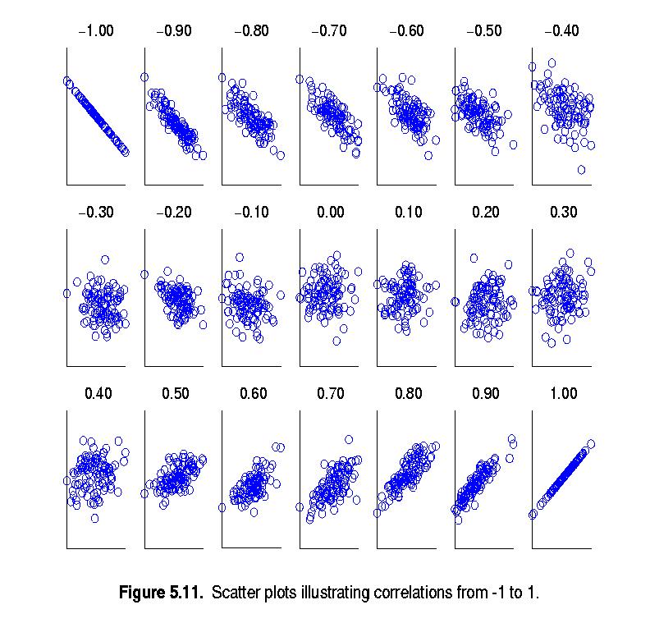
Visually Evaluating Correlation
Scatter plots showing the similarity from –1 to 1.

Slide 21
Correlation coefficient (also called Pearson’s product moment coefficient)
where n is the number of tuples, and are the respective means of A and B, σ_{A} and σ_{B} are the respective standard deviation of A and B, and Σ(a_{i}b_{i}) is the sum of the AB cross-product.
If r_{A,B} > 0, A and B are positively correlated (A’s values increase as B’s). The higher, the stronger correlation.
r_{A,B} = 0: independent; r_{AB} < 0: negatively correlated

Slide 22
Correlation (viewed as linear relationship)
Correlation measures the linear relationship between objects
To compute correlation, we standardize data objects, A and B, and then take their dot product

